Slide 1
Business Intelligence G. Mudare
Notes:
Introduce yourself to the students and also find out there names
Have them give you in 30 seconds a summary of who they are and what there interest in IT is

Slide 2
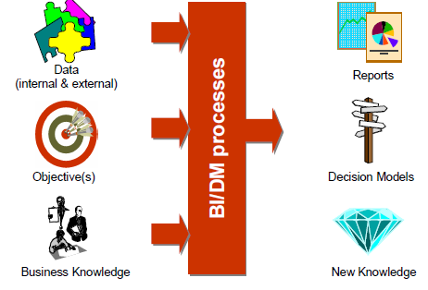
Data Pre-processing
Input-Output View
Notes:
1. Rely on systems, not motivation
Review any new information you’ve learned on the same day
This daily review won’t take long to complete, but it’s a vital step that ensures you stay on top of the material.
Applying this tip will also help you to move the information to your long-term memory more quickly.
ful students rely on systems to ensure that they get the work done, even when they don’t feel like it.
Write everything down
To be an effective student, write everything down.
This includes homework to be completed, test and exam dates, project deadlines, competition dates, school and family events, etc.
Don’t assume that you’ll be able to remember anything; write it all down to stay organised.
This tip might sound extreme, but life only gets busier as you get older. So this tip will serve you well for the rest of your life.
Create a rough weekly schedule
Write down your rough weekly schedule based on your recurring commitments
Get rid of distractions before they become distractions
The biggest obstacle to doing well in school is distractions.
To overcome distractions, you can’t depend on willpower. Few of us have the willpower necessary to fight off all the distractions that surround us in this digital era.
Here are some ways to eliminate distractions before they become distractions:
Turn off notifications on your phone/tablet
Delete all the apps that distract you
Put your phone/tablet in another room before you start work
Set a really, really long password to unlock your phone/tablet
Restrict your Internet access
Have only one tab open in your browser at any one time
Find an accountability partner as you make these changes
Don’t multitask
It’s a fact: There’s no such thing as multitasking.
Whenever you’re multitasking, you’re actually just switching between tasks. This reduces your studying efficiency.
So don’t multitask when you’re studying or doing your homework. Instead, focus on one task at a time, and you’ll find that you’ll get more done in less time.
Work in short blocks of time
I’ve found that most students can’t maintain a high level of focus for more than 45 minutes at a go.
As such, I generally recommend working in 30- to 45-minute blocks, followed by a 5- to 10-minute break.
Working in shorter blocks of time is more effective for the majority of students, rather than struggling to focus for a couple of hours straight.
Be organised
Students who aren’t organised end up wasting precious time looking for items or notes, or doing last-minute work they forgot about.
Keep track of important dates, deadlines, etc.
This is related to Tip #3, but it’s more specific.
I’ve worked with many students who try to keep track of important dates by storing them in their brains.
Needless to say, these students occasionally forget about upcoming tests or deadlines. This results in panic – and low-quality work too.
Use Google Calendar or Google Keep (an old-fashioned planner works too) to keep track of important dates, and you’ll become a more effective student.
Ask lots of questions
Asking your friends and teachers questions about what you’re learning is a great way to stay engaged. It also ensures that you understand the new material.
Don’t be afraid of asking silly questions. Besides, if you pay attention in class, your questions will likely be logical and insightful.
Do consistent work
Don’t do last-minute work, and don’t cram for exams.
Easier said than done, I know.
But if you do consistent work, you won’t even need to study that hard for your final exams.

Slide 3
Data Pre-processing
Problems of Real-world databases
Noisy Data
Missing Data→Attributes of interest may not always be available
inconsistent data
As a result of their huge size and origin from multiple, heterogenous sources.
Low-quality data will lead to low-quality mining results.
“How can the data be pre-processed in order to help improve the quality of the data and, consequently, of the mining results?
How can the data be pre-processed so as to improve the efficiency and ease of the mining process?”

Slide 4
Why Pre-process the Data?
Incomplete, noisy, and inconsistent data
Attributes of interest may not always be available
Relevant data may not be recorded due to a misunderstanding
Missing data, particularly for tuples(records) with missing values
Human or computer errors occurring at data entry
Errors in data transmission
Duplicate tuples(records): (redundancies)
Dirty data can cause confusion for the BI Task
Inconsistencies in format and naming

Slide 5
Forms of data pre-processing
Data cleaning :Handle Missing values, noise, and inconsistencies that contribute to inaccurate data.
Data integration : combines data from multiple sources into a coherent data store (data warehousing)
Data transformation : data are transformed or consolidated into forms appropriate for mining.
Data reduction Data reduction obtains a reduced representation of the data set that is much smaller in volume, yet produces the same (or almost the same) analytical results.
Discretization : to reduce the number of values for a given continuous attribute by dividing the range of the attribute into intervals.
Concept hierarchy generation: reduces the data by collecting and replacing low-level concepts (such as numerical values for the attribute age) with higher-level concepts (such as youth, middle-aged, or senior).

Slide 6
Descriptive Data Summarization
For data pre-processing to be successful, it is essential to have an overall picture of your data
Descriptive data summarization techniques can be used to identify the typical properties of your data and highlight which data values should be treated as noise or outliers.
For many data pre-processing tasks, users would like to learn about data characteristics regarding both central tendency and dispersion of the data.

Slide 7
Descriptive statistics
Measures of central tendency include
mean,
median,
mode,
midrange,
Measures of data dispersion include
quartiles,
interquartile range (IQR),
variance.

Slide 8
Descriptive Data Summarization
From the BI point of view, we need to examine how they can be computed efficiently in large databases.
It is necessary to introduce the notions of distributive measure, algebraic measure, and holistic measure.
Knowing what kind of measure we are dealing with can help us choose an efficient implementation for it.

Slide 9

Descriptive Data Summarization Measuring the Central Tendency
The most common and most effective numerical measure of the “center” of a set of data is the (arithmetic) mean
This corresponds to the built-in aggregate function, average (avg() in SQL), provided in relational database systems.

Slide 10
Descriptive Data Summarization Distributive Measure and Algebraic Measure
A distributive measure is a measure (i.e., function) that can be computed for a given data set or it its subsets
Both sum() and count() are distributive measures also max() and min().
An algebraic measure is a measure that can be computed by applying an algebraic function to one or more distributive measures.
average (or mean()) computed by sum()/count().

Slide 11
Descriptive Data Summarization
Weighted Arithmetic Mean
Sometimes, each value xi in a set may be associated with a weight wi, for i = 1; : : : ;N.
The weights reflect the significance, importance, or occurrence frequency attached to their respective values.
In this case, we can compute the weighted arithmetic mean or the weighted average.

Slide 12
Descriptive Data Summarization Holistic Measure
The mean is not always the best way of measuring the centre of the data
Mean is sensitive to extreme (e.g., Outlier) values.
Small number of extreme values can corrupt the mean.
A holistic measure is a measure that must be computed on the entire data set as a whole.
The median is an example of a holistic measure.
Holistic measures are much more expensive to compute than distributive measures (easily approximated)

Slide 13
Descriptive Data Summarization Measuring the Dispersion of Data
The degree to which numerical data tend to spread is called the dispersion, or variance of the data
The most common measures of data dispersion are range, the five-number summary (based on quartiles), the interquartile range, and the standard deviation.
Boxplots can be plotted based on the five-number summary and are a useful tool for identifying outliers.

Slide 14

Range, Quartiles, Outliers, and Boxplots
The range of the set is the difference between the largest (max()) and smallest (min()) values.
The kth percentile of a set of data in numerical order is the value xi having the property that k percent of the data entries lie at or below xi.
The median is the 50th percentile.
The first quartile, denoted by Q1, is the 25th percentile;
The third quartile, denoted by Q3, is the 75th percentile.
The quartiles, give some indication of the center, spread, and shape of a distribution.
The distance between the first and third quartiles (interquartile range (IQR) ) is a simple measure of spread

Slide 15
Range, Quartiles, Outliers, and Boxplots
Q1 , Q3 and IQR are holistic measures.
No single numerical measure of spread, such as IQR, is very useful for describing skewed distributions.
The five-number summary of a distribution consists of
Minimum;
Q1;
Median;
Q3;
Maximum:
Boxplots are a popular way of visualizing a distribution

Slide 16
BOX PLOTS
Ends of the box
are at the quartiles
median is line
within the box
Box length is
the
Interquartile
range, IQR
Whiskers outside the box extend to the smallest (minimum) and largest (maximum) observations.

Slide 17
Variance and Standard Deviation
The variance of N observations, x1;x2; : : : ;xN, is
x is the mean value of the observations
The standard deviation, of the observations is the square root of the variance,

Slide 18
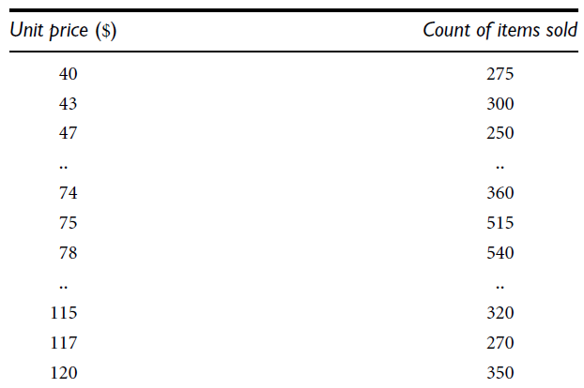
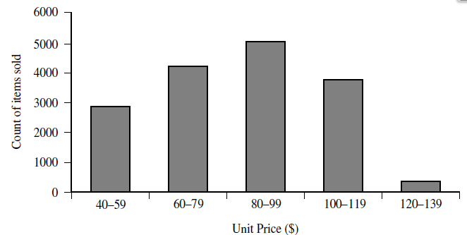
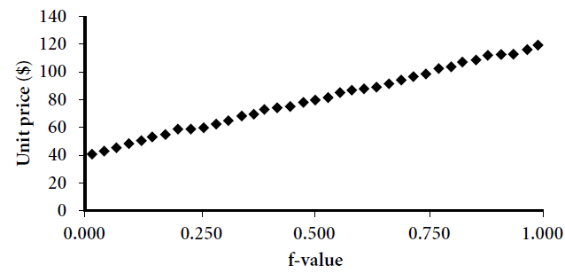
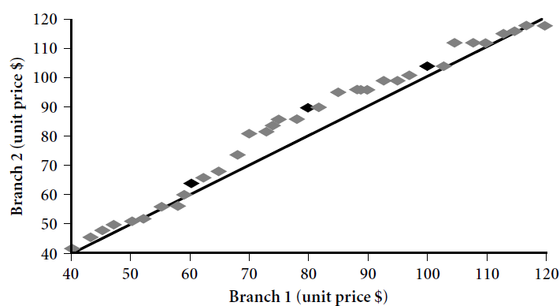
Graphic Displays of Basic Descriptive Data Summaries (Book Examples)
Histogram is graphical method for
summarizing
the distribution of a given attribute
q-q plot, plots the quantiles of one univariate distribution against the corresponding quantiles of another
q-q plot for unit price data
from two different branches
Quantile plot compares different
distributions based on their quantiles.

Slide 19
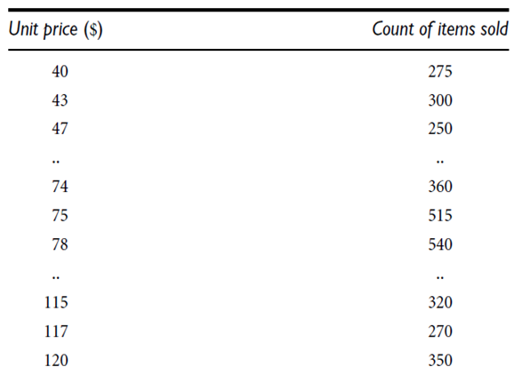
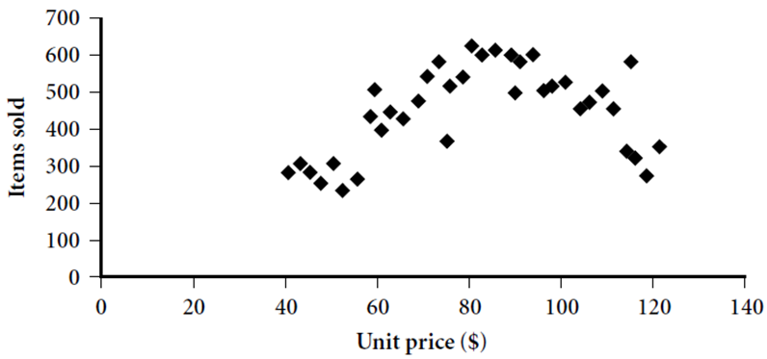
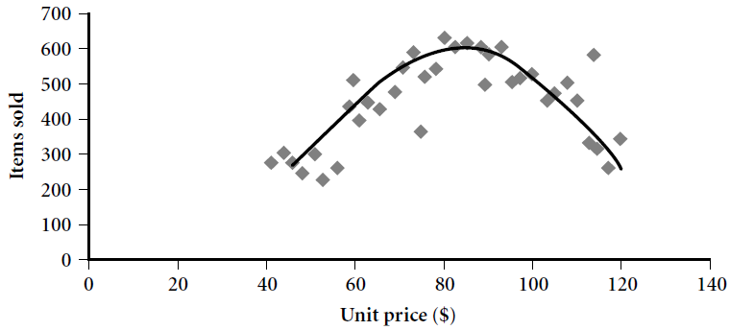
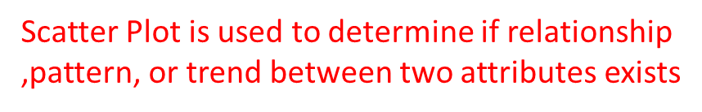
Graphic Displays of Basic Descriptive Data Summaries (Book Examples)
Scatter plot for the data set
Loess curve for the
data set
Loess curve adds a smooth curve to a scatter plot in order
to provide better perception of the pattern of dependence.

Slide 20
Data Quality
A well-accepted multidimensional view of data quality:
–Accuracy
–Completeness
–Consistency
–Timeliness
–Believability
–Interpretability
–Accessibility

